Slide 1

UE19CS353 – Object Oriented Analysis and Design with Java
Theory ISA (Mini Project)
Presentation on
Pharmacy Inventory Management System
By:
B Pravena – PES2UG19CS076
Bharath Kumar S P – PES2UG19CS087
Bhuvantej R – PES2UG19CS092
6th Semester
PES University, Bengaluru
(Established under Karnataka Act 16 of 2013)
Department of Computer Science & Engineering
Session: Jan - May 2022

Slide 2
Object Oriented Analysis and Design with Java (Mini Project)
Project Description
Pharmacy management system stores and manages Medicine, company and agent details.
It helps in storing the data, organizes the entire system, controls the use of medication & improves customer satisfaction.
Our project helps the business owner to control their stock, accounting and choose the right medication. With all the basic and advanced pharmacy features it helps in controlling all the business activities .
Agents are able to sell the stock to different vendors and automatic bill get printed.
GitHub Link - https://github.com/bkumarsp/PharmacyInventoryManagementSystem

Slide 3
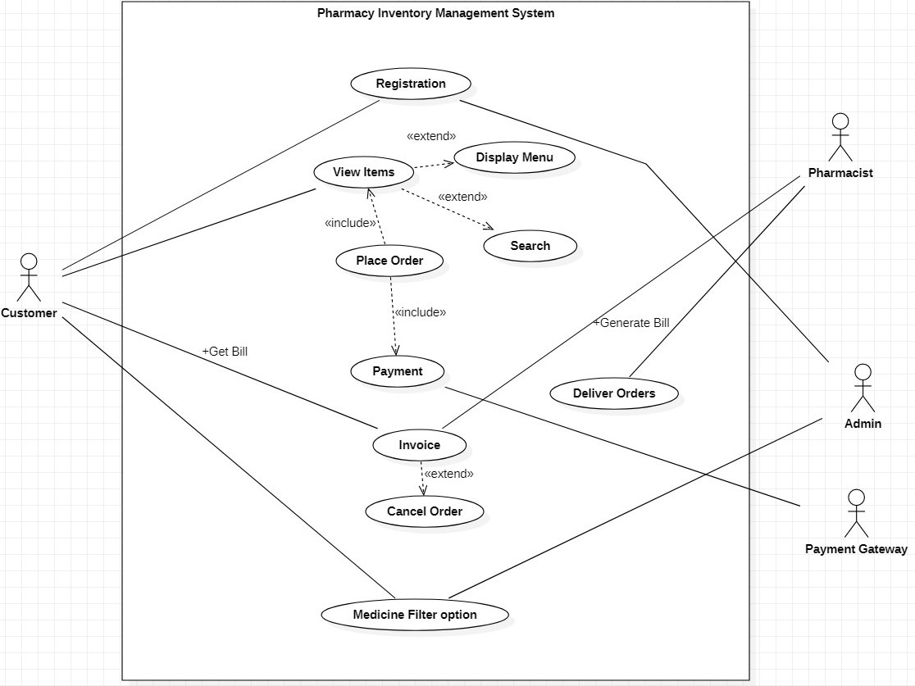
Object Oriented Analysis and Design with Java (Mini Project)
Analysis and Design Models
USE CASE diagram

Slide 4
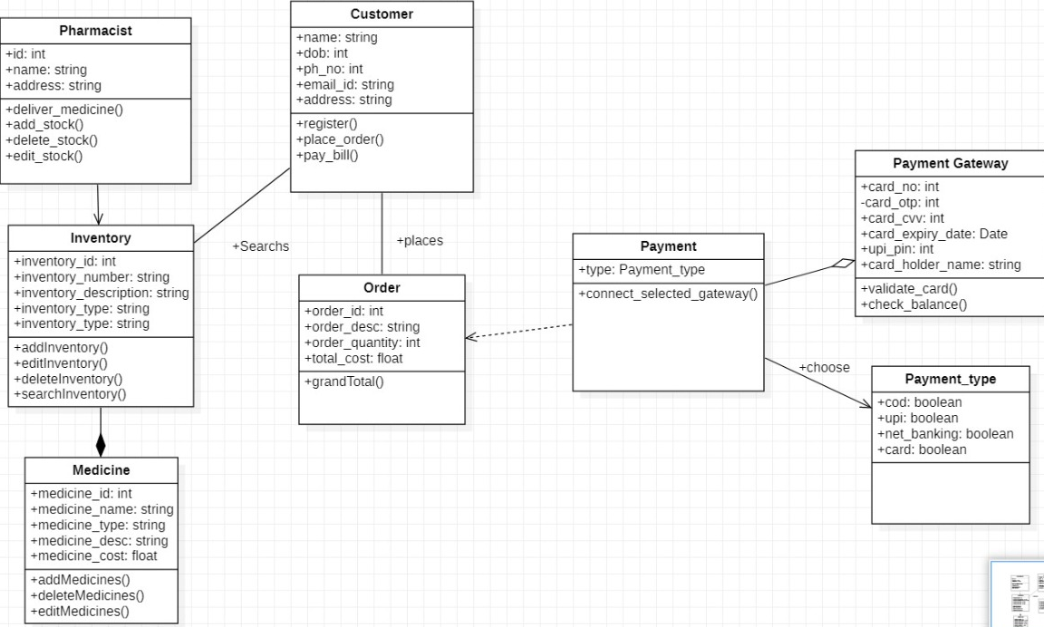
Object Oriented Analysis and Design with Java (Mini Project)
Analysis and Design Models
Class Diagram

Slide 5
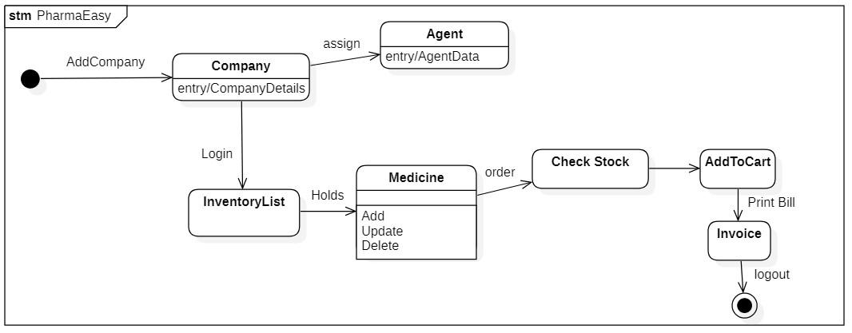
Object Oriented Analysis and Design with Java (Mini Project)
Analysis and Design Models
State Diagram

Slide 6
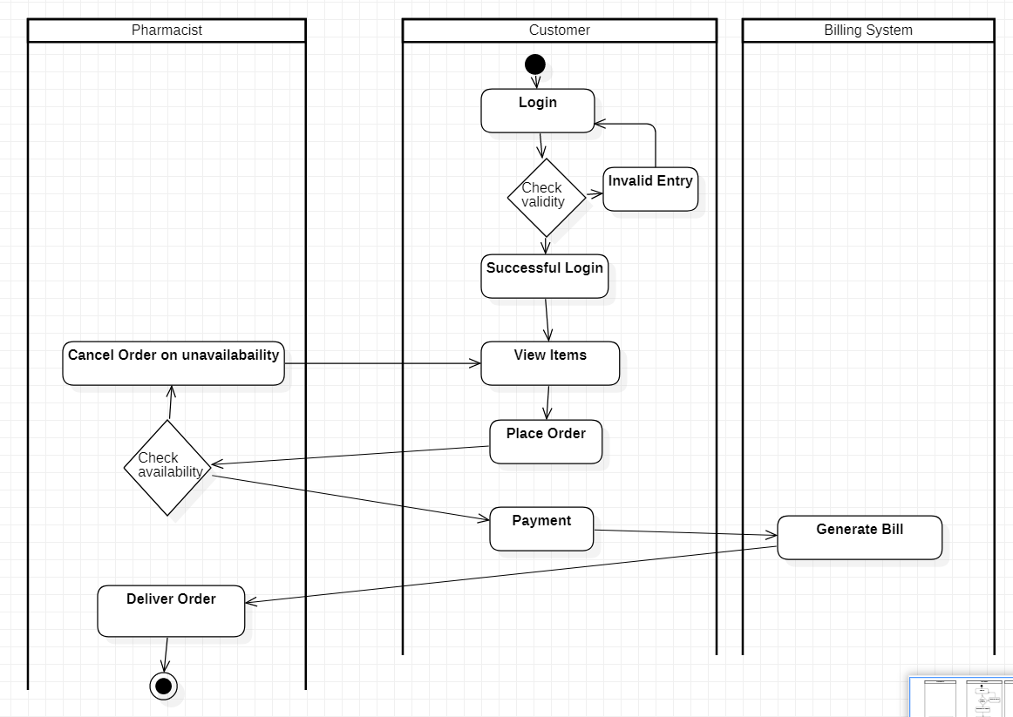
Object Oriented Analysis and Design with Java (Mini Project)
Analysis and Design Models
Activity Diagram

Slide 7
Object Oriented Analysis and Design with Java (Mini Project)
Tools and Frameworks Used
IDE:NetBeans
NetBeans is an integrated development environment for Java. NetBeans allows applications to be developed from a set of modular software components called modules.
DATABASE: JavaDB
Java DB is a relational database management system (RDBMS). Data is stored and queried via SQL or JDBC.
FRAMEWORK: Swing
The Swing Application Framework is a Java specification for a simple application framework.

Slide 8
Object Oriented Analysis and Design with Java (Mini Project)
Design Principle and Design Patterns Applied
Design Principle:- Single responsibility Principle(SRP)
MedicineClass
AgentClass
CompanyClass
Design Patterns:- Facade
SellerClass
Facade is a structural design pattern that provides a simplified interface to a complex system of classes, library or framework.

Slide 9
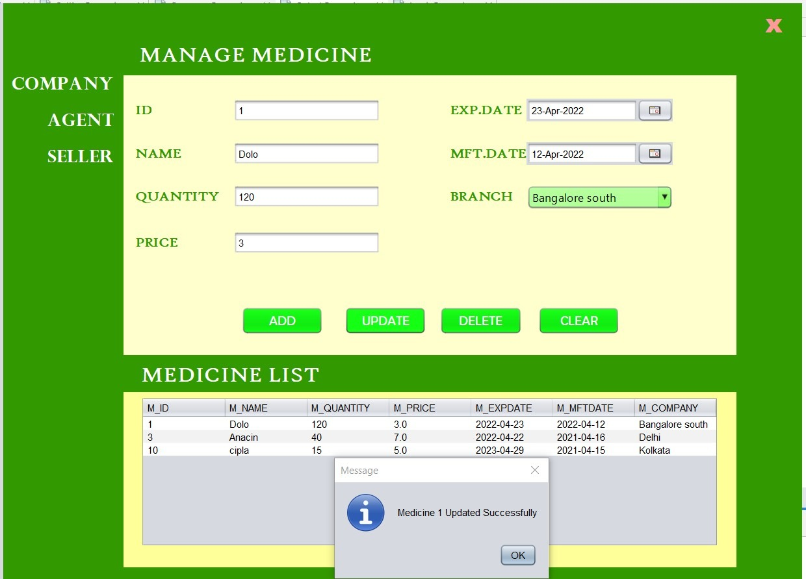
Object Oriented Analysis and Design with Java (Mini Project)
Screenshots
Inventory page

Slide 10
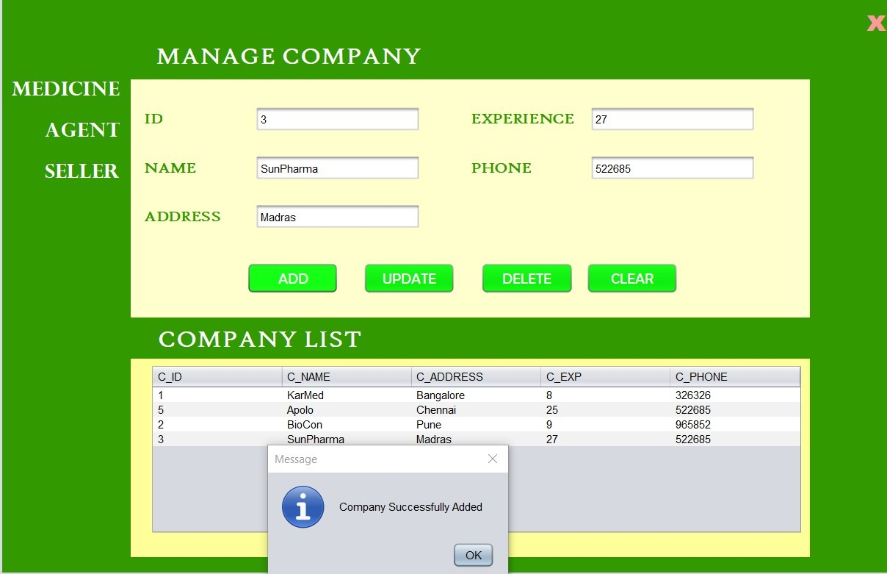
Object Oriented Analysis and Design with Java (Mini Project)
Screenshots
Company page

Slide 11
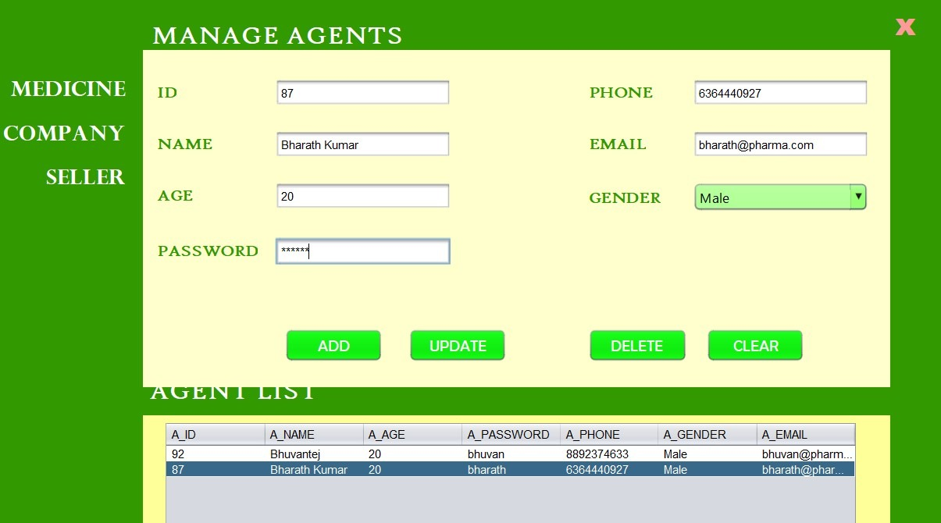
Object Oriented Analysis and Design with Java (Mini Project)
Screenshots
Agent page

Slide 12
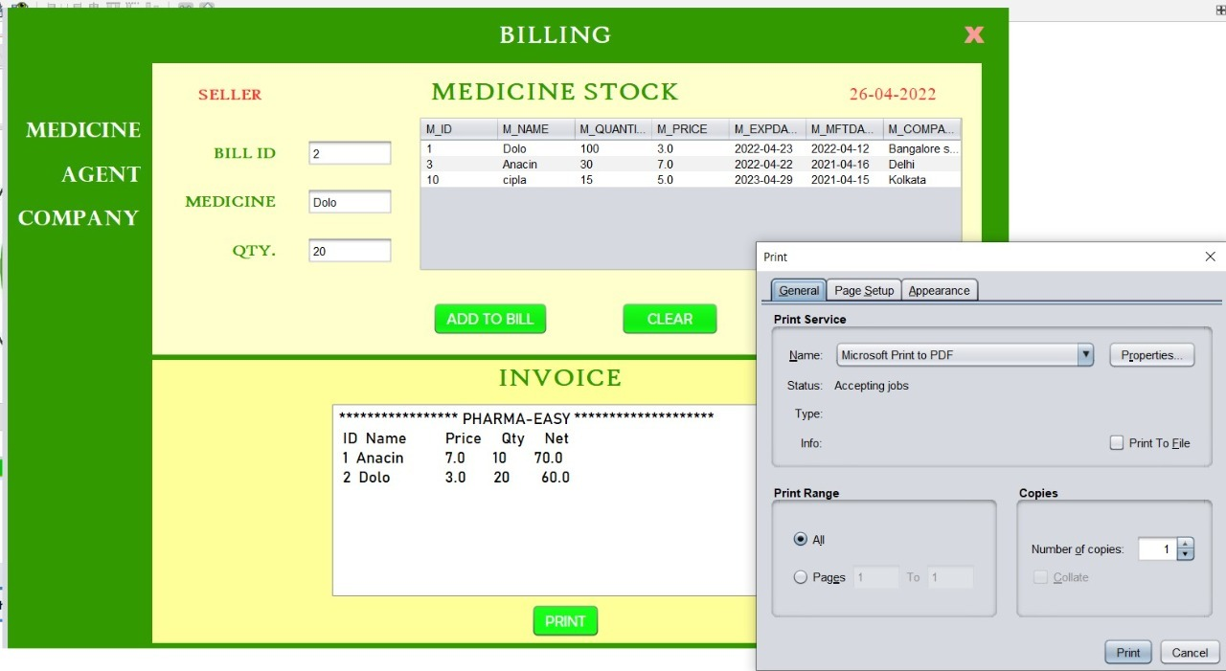
Object Oriented Analysis and Design with Java (Mini Project)
Screenshots
Seller page

Slide 13
Object Oriented Analysis and Design with Java (Mini Project)
Team member contributions
B Pravena(PES2UG19CS076)
→ Medicine class
→ Company class
→ Database Queries for Inventory System
Bharath Kumar S P (PES2UG19CS087)
→ Seller class
→backend database connection, Invoice
→Bill generation and Medicine Queries
Bhuvantej R(PES2UG19CS092)
→Agent class ,
→User table creations
→Database Query for Agent profile

